Slide 1



Slide 3

Meet the characters who will help us become Green Ambassadors!

Slide 4

Help Crush to throw away and recycle whatever we can to help save energy and protect natural resources.

Slide 5


Slide 6

Smith wants to encourage people to grow some of their own food and eat plenty of fruit and vegetables.

Slide 7


Slide 8

Will you help Tap to save water in your school and at home?

Slide 9


Slide 10

Help Switch protect the environment by getting people to use less energy.

Slide 11


Slide 12

Leafy encourages groups to help provide places that will encourage a wide range of plants and animals to thrive in your area.

Slide 13
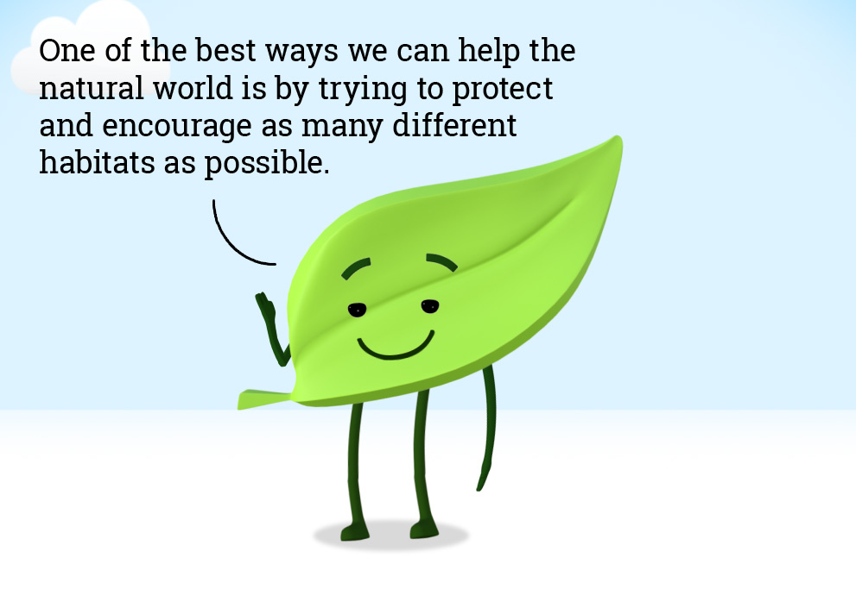

Slide 14

Help Wheel make the roads safer and cut down pollution by encouraging people to get around without using a car all the time.

Slide 15
How can we all take part and make our school an
Eco-School?

Slide 16
We want you all to become Green Ambassadors!
You can start by helping making our school more environmentally friendly and also tell the rest of your family how they can help at home too!

Slide 17
Our first topic we are going look at is Litter
We will be running a poster competition with a prize winner from each year group whose poster we will be using throughout the school to help us to love our environment and not drop or create litter. A form will be given to each of you to have a go at creating a poster.
Here are some examples to give you ideas:

Slide 18


Slide 19

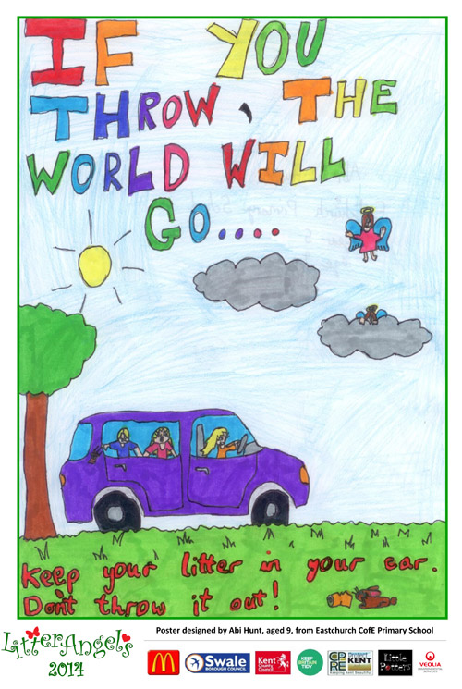

Slide 20
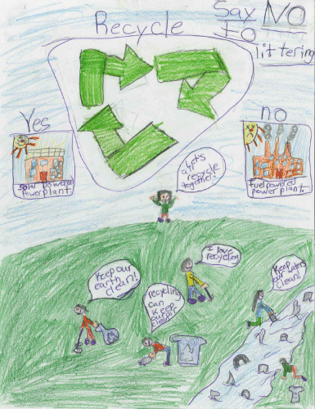
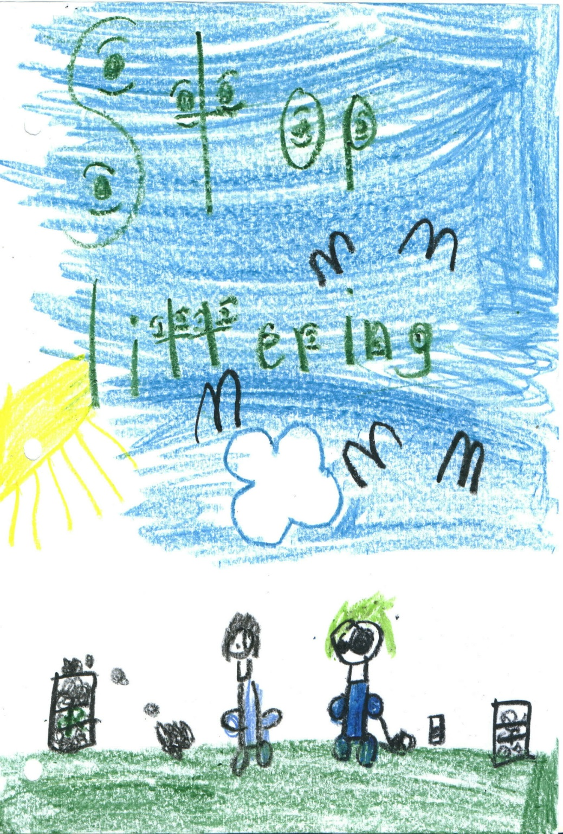

Slide 21


Slide 22

YOUR IDEAS!
Please let us have your ideas – we have post box by the Eco-School Noticeboard where you can also get a special form for you to write down your ideas as to how we might make our school better. When you have written down your idea post it in the post box so the committee can consider if we might be able to use any of the suggestions.

Slide 23
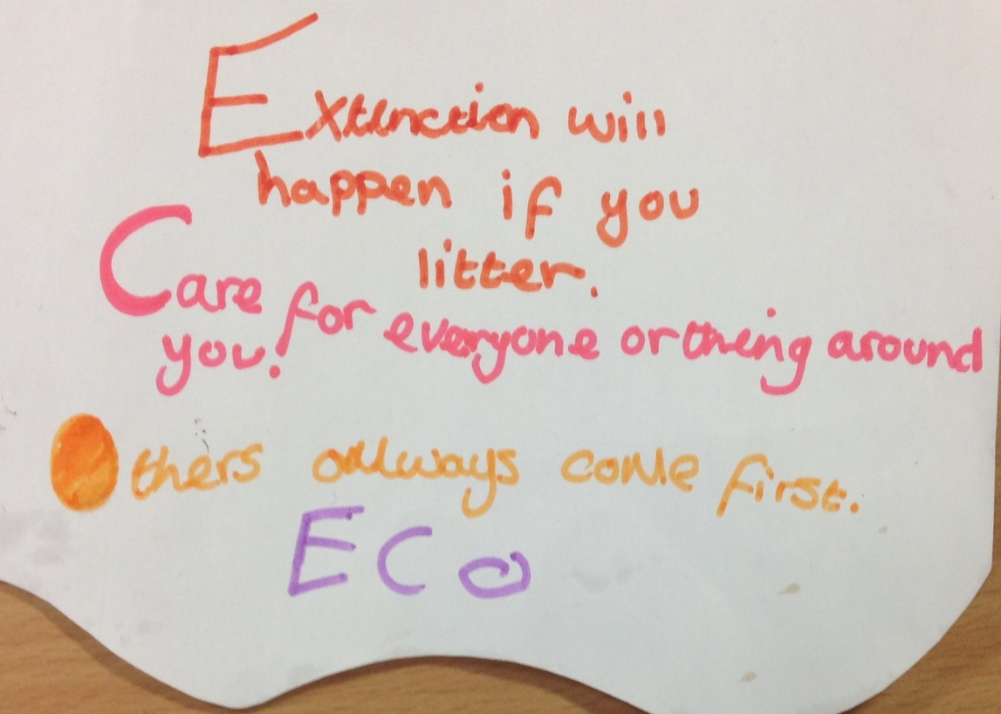
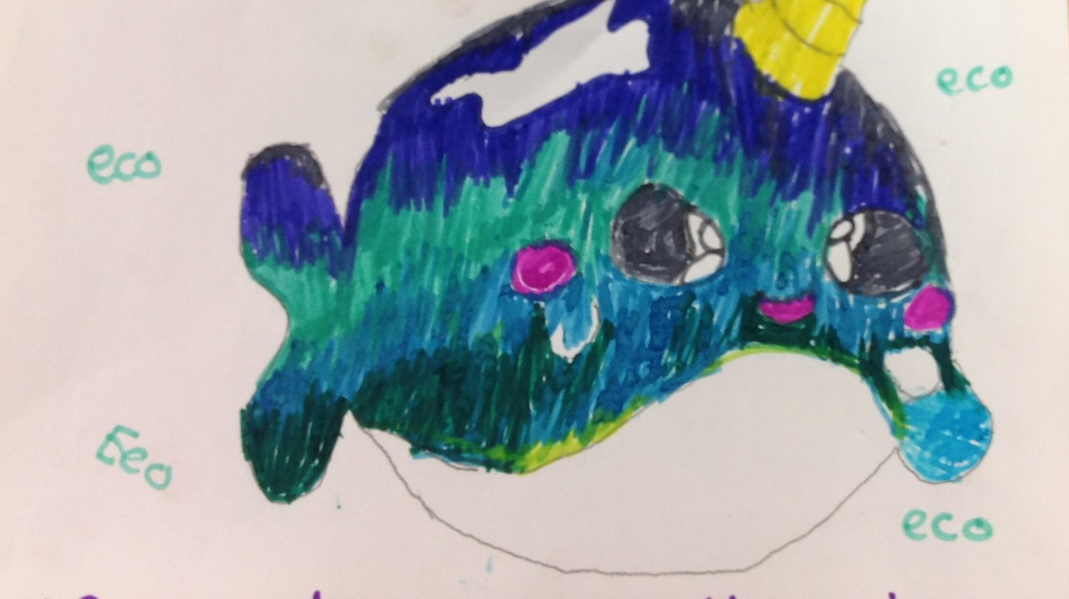
YOUR ARTWORK!
If you have a drawing that shows something about Eco-Schools, any of the nine topics or something about environment please give it to one of the eco warriors if you would like to have it displayed on the Eco-School noticeboard. A picture will be chosen each week to put on display.

Slide 24

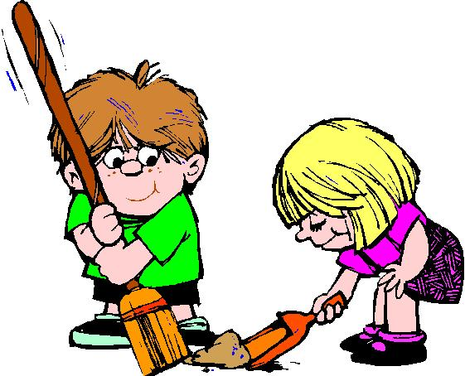
ENVIRONMENTAL PATROL
We would like to start having a rota of litter pickers from each class organised by the Global Warriors. They will also be encouraged to report back to Mr Burton when they notice that there may be an environmental problem around the school.

Slide 25

For listening – remember to spread the word!
Our first big event everyone will be involved in is
WASTE WEEK
18th -22nd March 2019

